Slide 1
Filled Maps

Slide 2
Filled Maps
Filled maps are one of the easier chart types to create in Tableau using Show Me.
To do so, simply click a geographic dimension (identified by a globe icon) from the Dimensions Shelf and choose ‘filled maps’ under Show Me.
To create a filled map manually, we will double-click on the geographic dimension for State in the Sales – Superstore data set that comes with Tableau.

Slide 3
Filled Maps
By default, Tableau generates a symbol map, placing a circle at the intersection of Longitude and Latitude for each state. In keeping with the “looking under the hood” theme of not relying on Show Me, take a look at the location of each dimension and measure.
First, Longitude is on the Columns Shelf, which can also be thought of as the X-axis.
Conversely, Latitude is on the Rows Shelf, or the Y-axis.
On the Marks Shelf, we can see that State is the most granular level of detail in the view. Even without seeing the map in the view, we should be able to guess what Tableau will display just by seeing the geographic fields on the Columns Shelf and Rows Shelf, the level of detail on the Marks Shelf, and the mark type of ‘Automatic’ (which is ‘Circle’ by default).

Slide 4
Filled Maps
In order to change this from a symbol map to a filled map, change the mark type from ‘Automatic’ to ‘Filled Map’. By selecting this special mark type in Tableau, you will see that the single circles on each state have been converted to nice, smooth polygons that trace the entire border of each state.
From here, you can encode the filled map by color by placing a field on the Color Marks Card.
Perhaps you want to color the territories by a measure such as Sales or Profit.
You can also color the marks by a dimension, as is the case in this example, where the states are colored by the Region dimension.

Slide 5
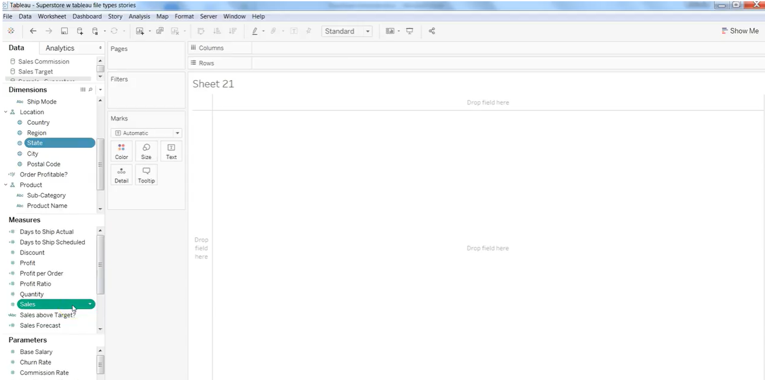
Filled Maps

Slide 6
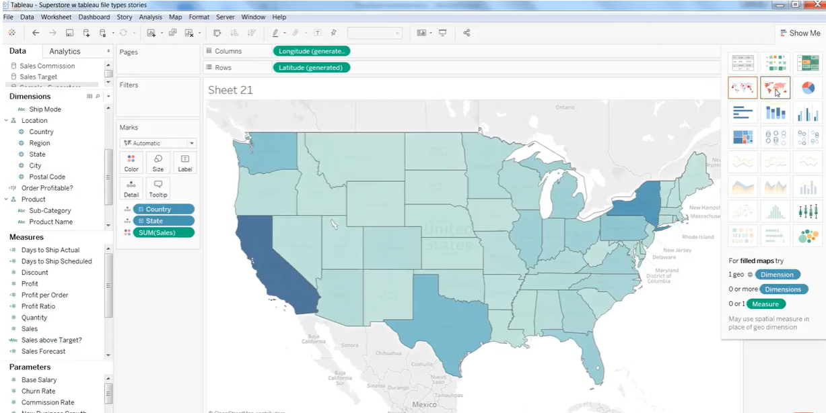
Filled Maps

Slide 7
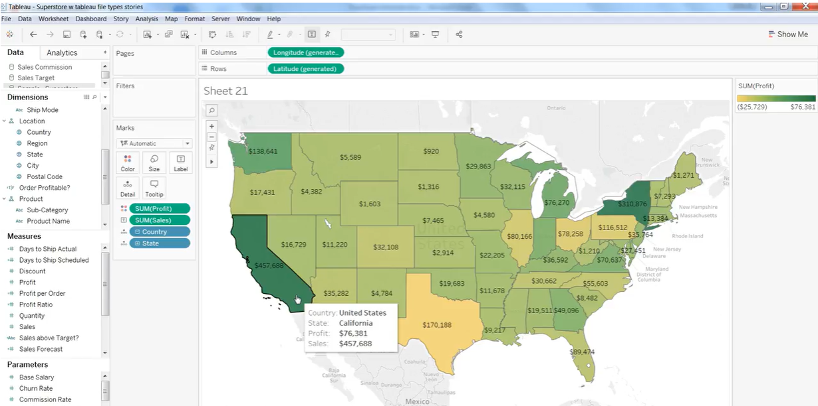
Based on the Sales, we can see the maximum profit

Slide 8
Dual Axis Maps
This type of map is useful any time you want to combine two maps into one to help provide additional context that would not be available when showing only one map or the other.

Slide 9
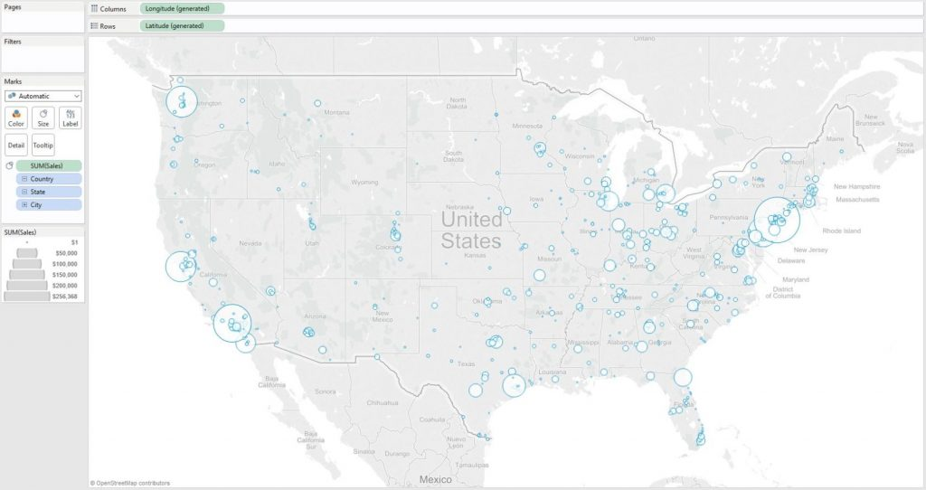
Create the First Map
To create a dual-axis map in Tableau, start by creating one of the two maps that you want to combine. We will start this example by creating a symbol map for sales by city.
Create the First Map
To create a dual-axis map in Tableau, start by creating one of the two maps that you want to combine. We will start this by creating a symbol map for sales by city.

Slide 10
Duplicate to Create the Second Map
Once the first map is created, you can create a duplicate of that map in one of two ways:
While holding the Control key, left click and drag the Longitude field on the Columns Shelf or the Latitude field on the Rows Shelf right next to itself. This is a shortcut for duplicating fields that works with any blue or green pill in Tableau.
Drag Longitude from the Measures Shelf to the second position on the Columns Shelf or Latitude from the Measures Shelf to the second position on the Rows Shelf.

Slide 11
Combining the Maps
To combine the maps, click on the second geographic measure on the Rows or Columns Shelf (depending on whether you duplicated Longitude or Latitude) and click “Dual-Axis”.
If you want to change the float order of the maps, drag the second geographic measure on the Rows or Columns Shelf to the first position.

Slide 12
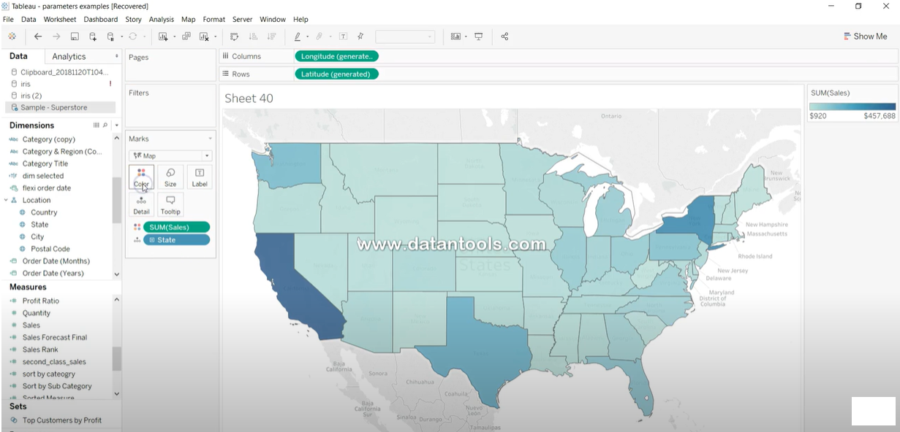
Dual Axis Maps

Slide 13
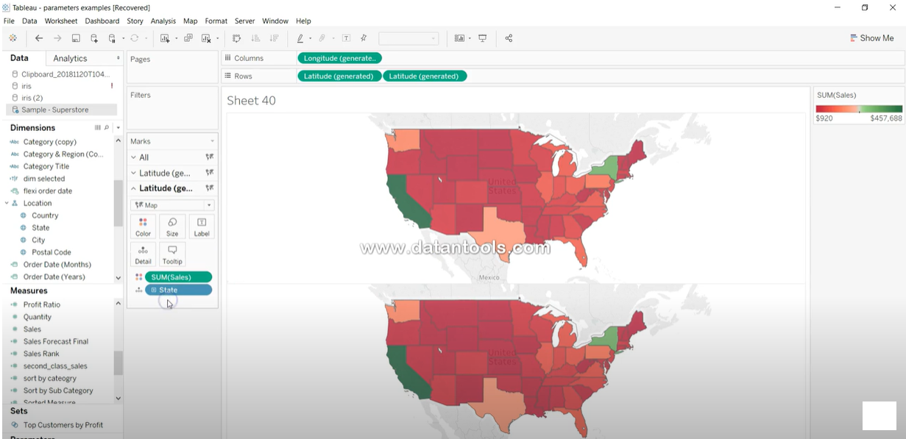
Dual Axis Maps

Slide 14
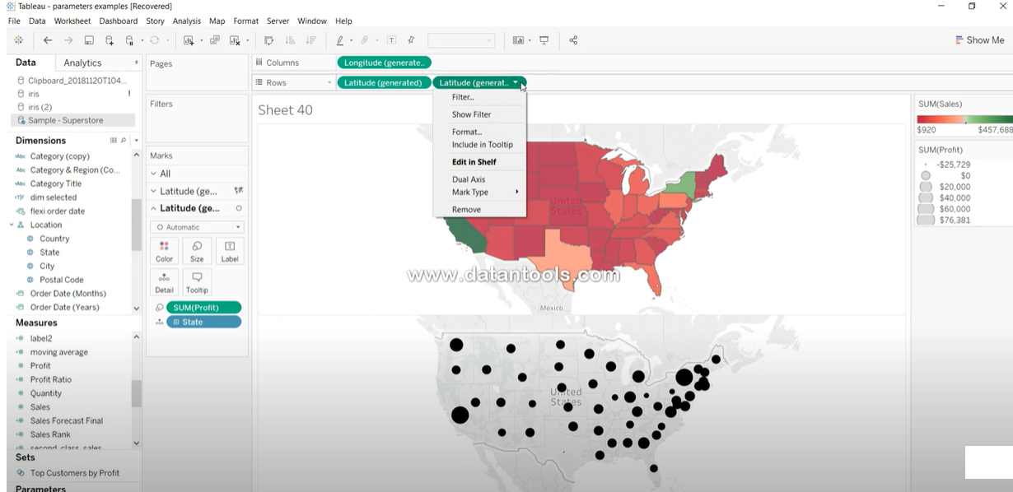
Dual Axis Maps

Slide 15
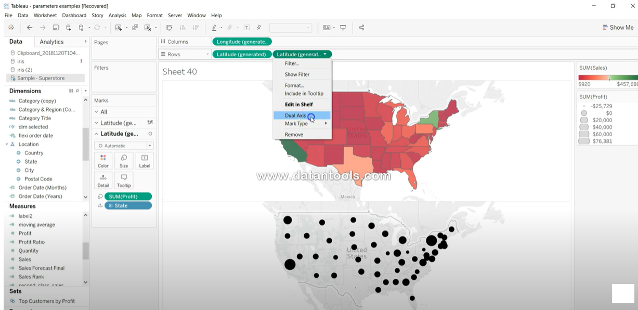
Dual Axis Maps

Slide 16
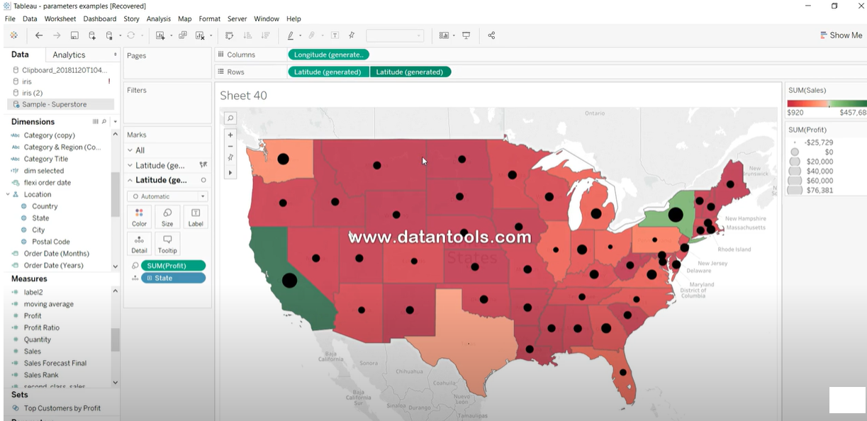
Dual Axis Maps

